Slide 1

Job Market Analysis Project
PROJECT ID: PRDA – 04

Slide 2
Project Overview
• Objective: Analyze job market data to derive key insights into job roles, skills, and salary trends.
• Tools Used: MySQL, Power BI, Excel.
• Dataset: Cleaned and transformed data of job listings including roles, salaries, locations, and required skills etc.
• Focus: Data-related roles such as Data Scientist, Data Analyst, Data Engineer, etc.

Slide 3
Data Cleaning & Transformation
• Handled non-null values represented as 'na' and '-1'.
• Extracted salary ranges and computed average salary.
• Standardized job titles and other categorical fields.

Slide 4
Data Preparation & Analysis using MySQL
Connected to MySQL database using MySQL Workbench
Handled special placeholder values like 'na' and -1
Cleaned the dataset for null-like values
Extracted data for specific job roles (e.g., Data Scientist)
Grouped data by industry and location features
Created filtered CSVs from query results for easy visualization

Slide 5
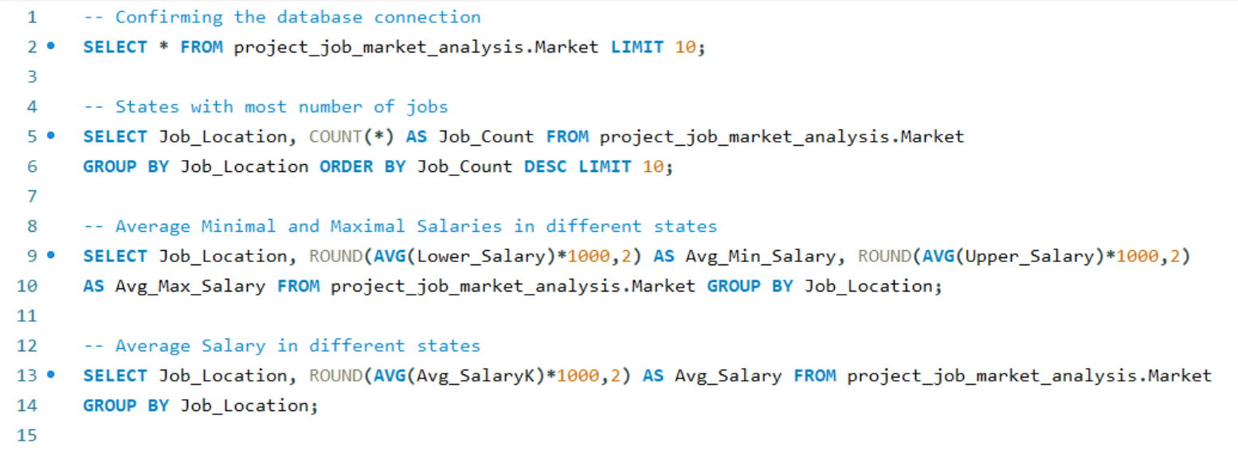

Slide 6
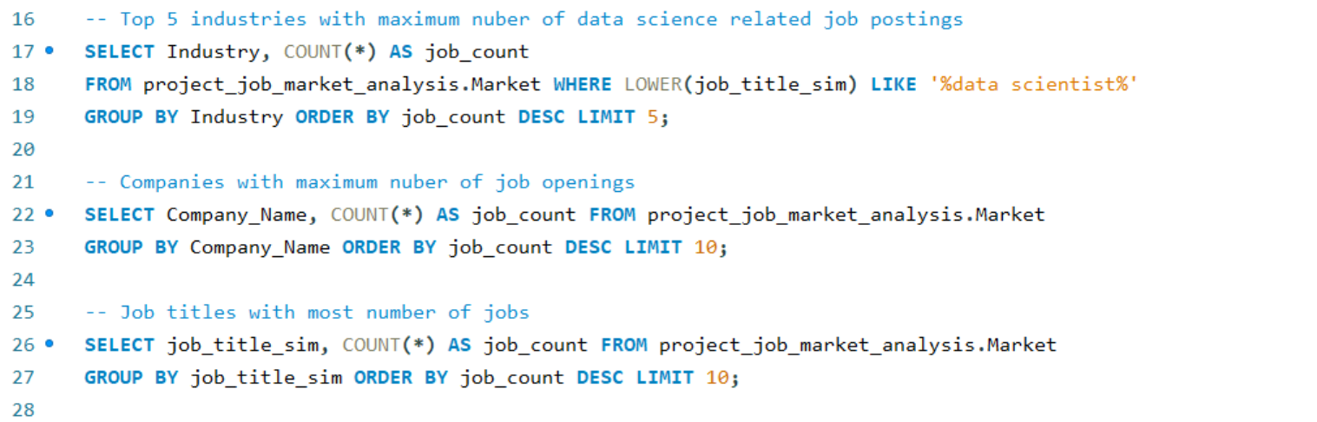

Slide 7
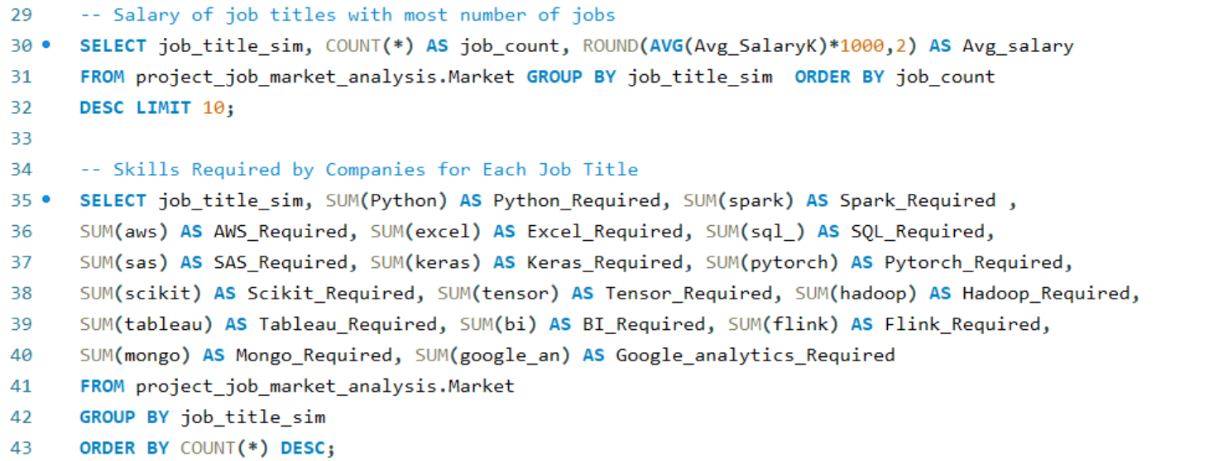

Slide 8
Power BI Visualizations
• Job distribution by industry and job role.
• Skill demand across different roles using heatmaps.
• Salary trends by job location (state-wise).
• Role-wise salary distribution and average salary insights.

Slide 9
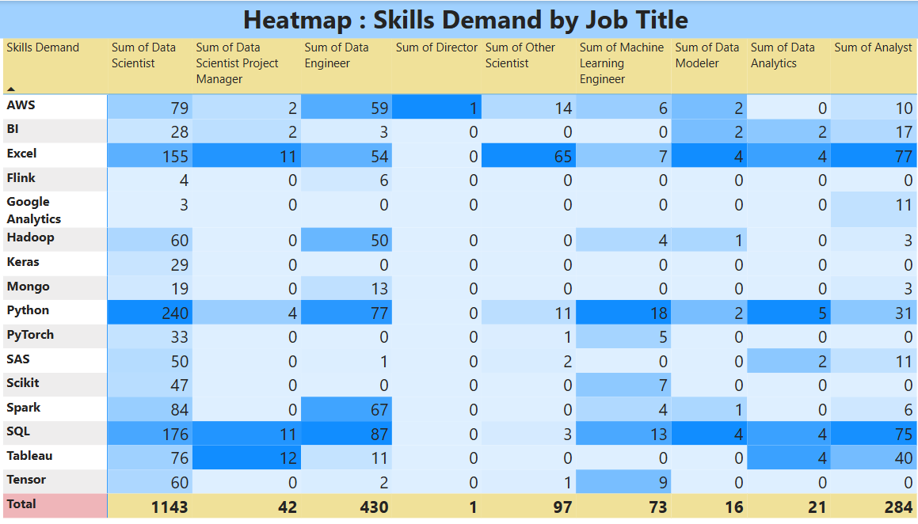

Slide 10
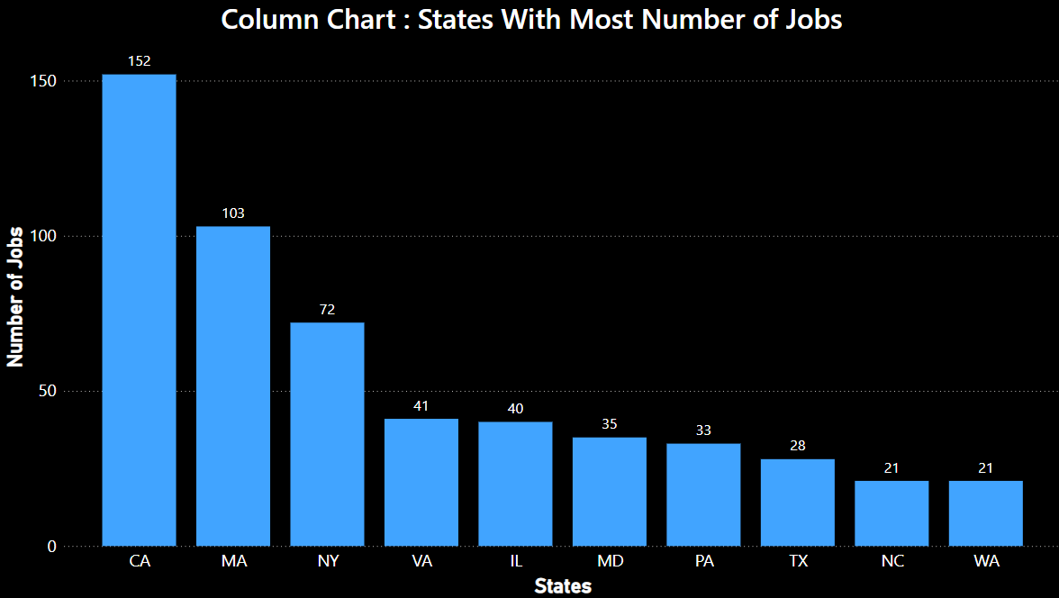

Slide 11
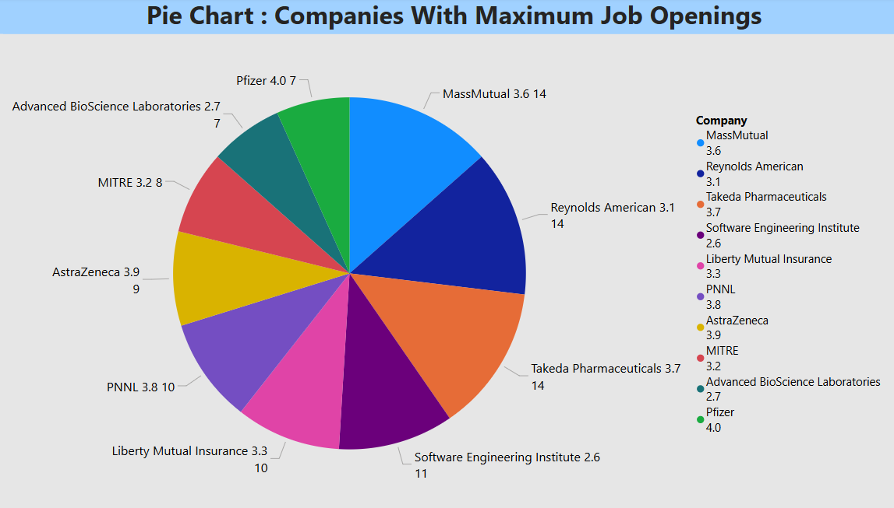

Slide 12
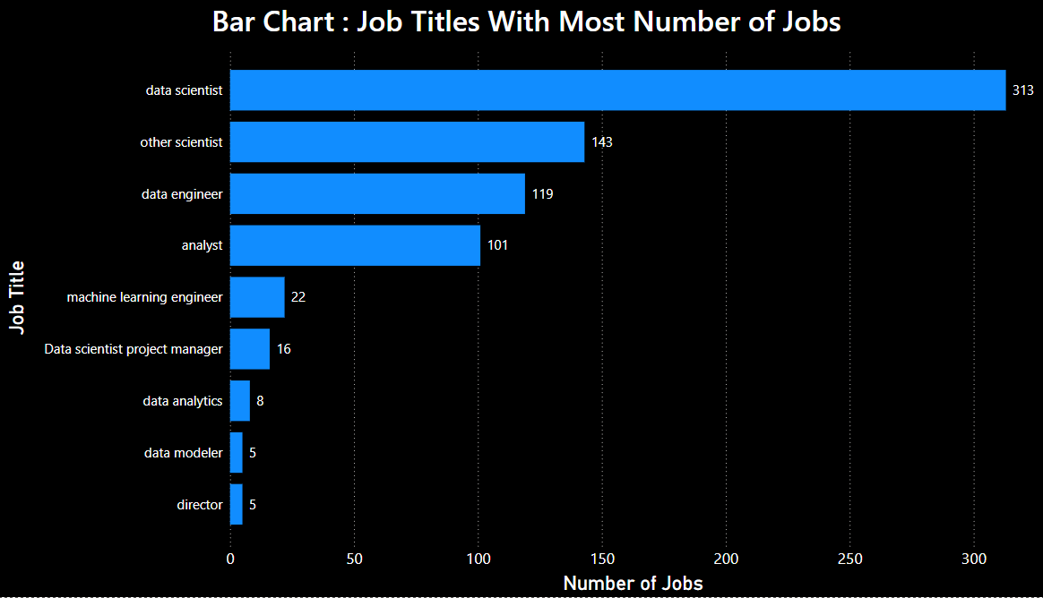

Slide 13
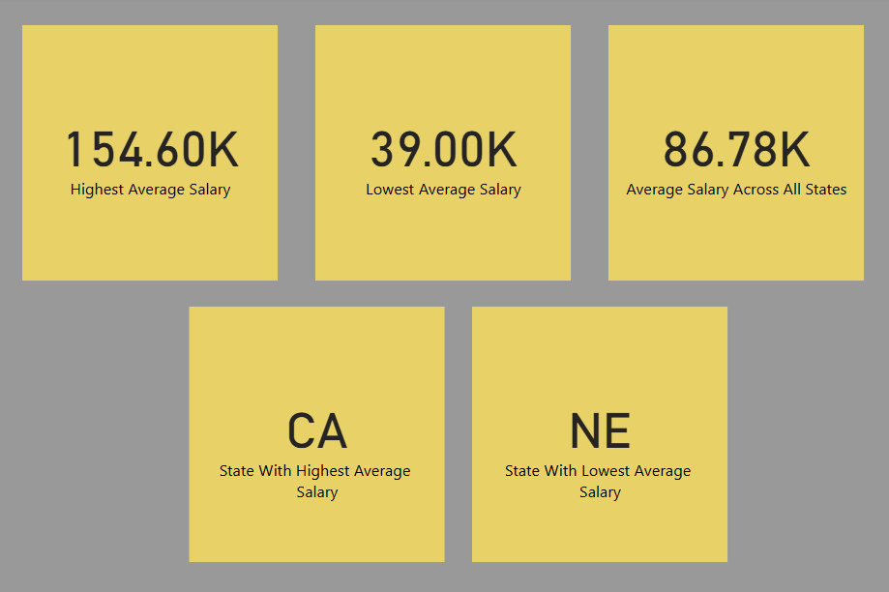

Slide 14
Key Insights
State with most number of data oriented jobs is California.
Biotech & Pharmaceuticals is the top industry with most Data Scientist jobs.
MassMutual is the company with most job openings.
Most in-demand role: Data Scientist.
Director is the Job-title with Highest Salary.
Top 3 skills: Python, SQL, Excel.
California offers the highest average salaries.
PhD holders have higher chance of earning higher salary than Master degree holders
Clear trend of higher salary in tech-centric states.

Slide 15
Recommendations
Based on the analysis, Python, SQL, Excel, and Tableau are among the most in-demand skills across job roles. Upskill teams or job seekers in these tools to match market demand.
States like California, Illinois and Massachusetts offer higher average salaries and have a greater concentration of job postings. Prioritize hiring efforts or job applications in these high-demand states.
“Data Scientist” and “Data Engineer” are the most frequently posted roles. For companies, tailor job descriptions and training programs toward these roles. For job seekers, focus resume and learning paths accordingly.
Biotech & Pharmaceuticals industry has the highest number of job postings, followed by Computer Hardware & Software and Insurance Carriers. Align industry partnerships, project experience, or job applications toward these sectors.

Slide 16
Conclusion
Used MySQL for data analysis.
Performed detailed data visualization using Power BI.
Analyzed patterns in skills, salary ranges, job roles, education, industries, and locations.
This analysis provides valuable insights into the current job market trends for data-related roles. Power BI helped in visualizing the impact of location, skills, and job role on salaries and demand.

